Slide 1
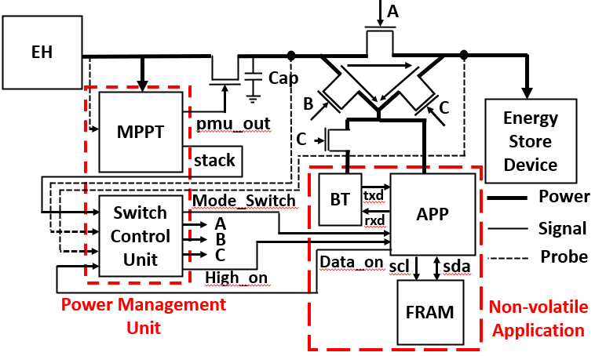
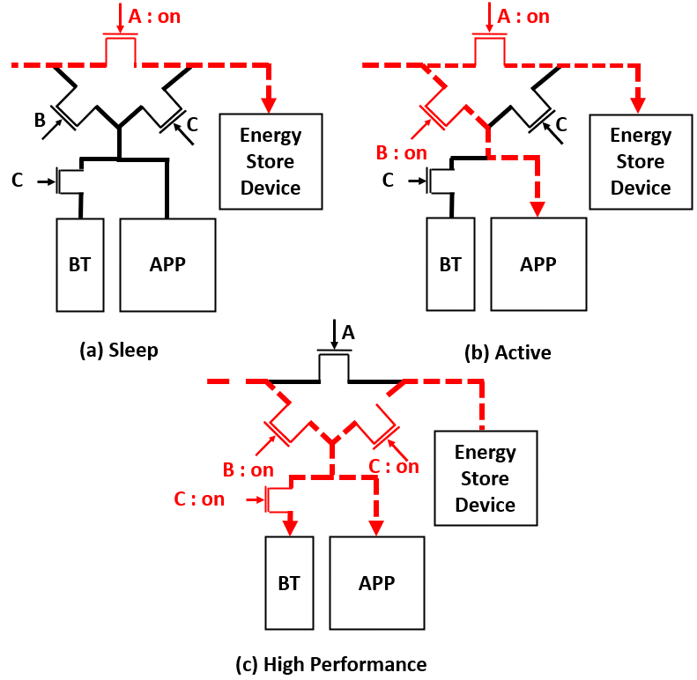
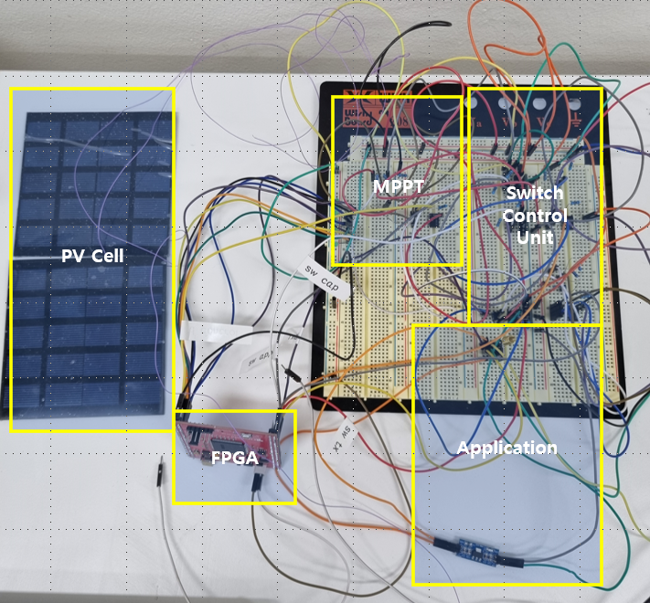
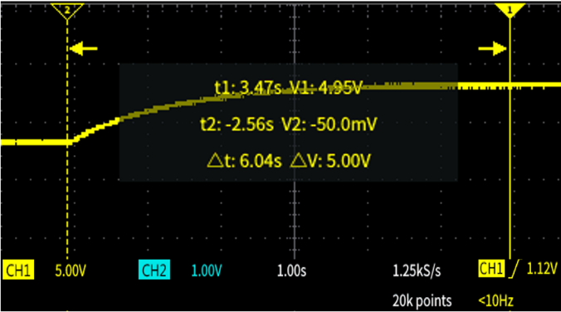
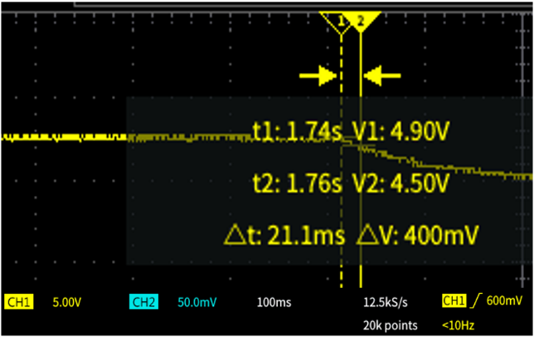
High power energy harvesting system for IoT sensor node system
Yongseok Kim, Chanhwi Roh, Yongsu Park, Donkyu Baek
Chungbuk National University
Existing IoT sensor nodes operate by receiving energy from batteries. However, due to the characteristics of sensor nodes that are widely distributed to collect various information, there is a disadvantage in that batteries must be replaced periodically. To overcome this, energy harvesting has been introduced. However, the harvested power is quite limited, making it difficult to use in applications that require high power momentarily, such as telecommunications. In this paper, we propose a high-output energy harvesting system design of a switch control unit that compensates for limited harvest energy with an energy storage device such as a capacitor. To verify the proposed system, a photovoltaic-based energy harvesting system was implemented, and the maximum supply power and maximum supply time of the application according to the capacity of the energy storage device were confirmed.
1. System Configuration
As power is supplied from the energy harvesting device (EH), the power management unit tracks the maximum power point (MPPT) and outputs pmu_out to pass power when the measured voltage is higher than the maximum power point. let it And it transmits the information (Stack) on the trend of power to the Switch Control Unit so that it can operate in Active, Sleep, or High Performance depending on the energy. The switch control unit determines the operation of the APP based on the power trend and current voltage information (probe). Mode_Switch is used to control the operation of the APP, and when operating in high performance, it is operated when the result data of the APP is saved. In addition, by determining how much power is currently supplied and the direction of energy through the Stack, control Switch A, B, and C to directly supply the energy supplied by energy harvesting to the application, charge the energy storage device, or require high power. It simultaneously supplies stored energy and harvested energy to operate the Bluetooth (BT) module.
On the other hand, the non-volatile application consists of an APP part that processes data, a BT module that transmits data, and FRAM, which is a non-volatile memory that backs up and restores data according to the operation mode.
2. Energy Harvesting System
The table on the right shows the current consumed. Current consumption means the average current when the module operates, and the maximum current when cut-off means the minimum current that can operate the module. When only the APP operates, the minimum supply voltage is 5v, the minimum supply current is 40mA, and the minimum power is 0.2W. Since the maximum power that can be supplied when using a solar panel is up to 0.3W, APP can be supplied only through energy harvesting. However, when operating HC-06 simultaneously, the minimum power is 0.36W, which is less than the maximum power supplied. Therefore, energy is supplied from Cap.
 | Operating Current | Cut-off Current
APP : On BT : Off | 36mA | 40mA
APP : On BT : On | 60mA | 80mA
3. Operation Verification
As shown in the figure, power is supplied through the PV cell, and power and switch are controlled through the FPGA. Depending on the switch, whether the application is running or not is determined.
Based on the result of measuring the voltage value and time of Cap in Active mode and High mode, it was confirmed that 60mA, which is the current that both APP and BT module can operate, is supplied according to the cap's current formula as shown in the table. The FPGA board used Xilinx's Spartan 6 Evaluation Board, and through the results, it was confirmed that the value was well delivered.
Conclusion
In this paper, MPPT is used to control the amount of power coming in through energy harvesting, and the switch control unit analyzes the amount of power using probes and stacks to control non-volatile applications to operate in accordance with the power. It is designed to be stored as an energy storage device or supplied to APP. And the proposed switch system was checked for each mode, and High Performance mode is possible for 21.1 ms. However, it is expected that the operation time of High Performance mode can be increased by increasing the size of the capacity.
In the future, we plan to design a switch control unit to understand the power fluctuation and check if it is sufficient to operate in each mode. By using the proposed high-power energy harvesting system to drive high-power applications such as wireless communication, it is expected that the range of energy harvesting for high-power systems can be expanded.

